Slide 1
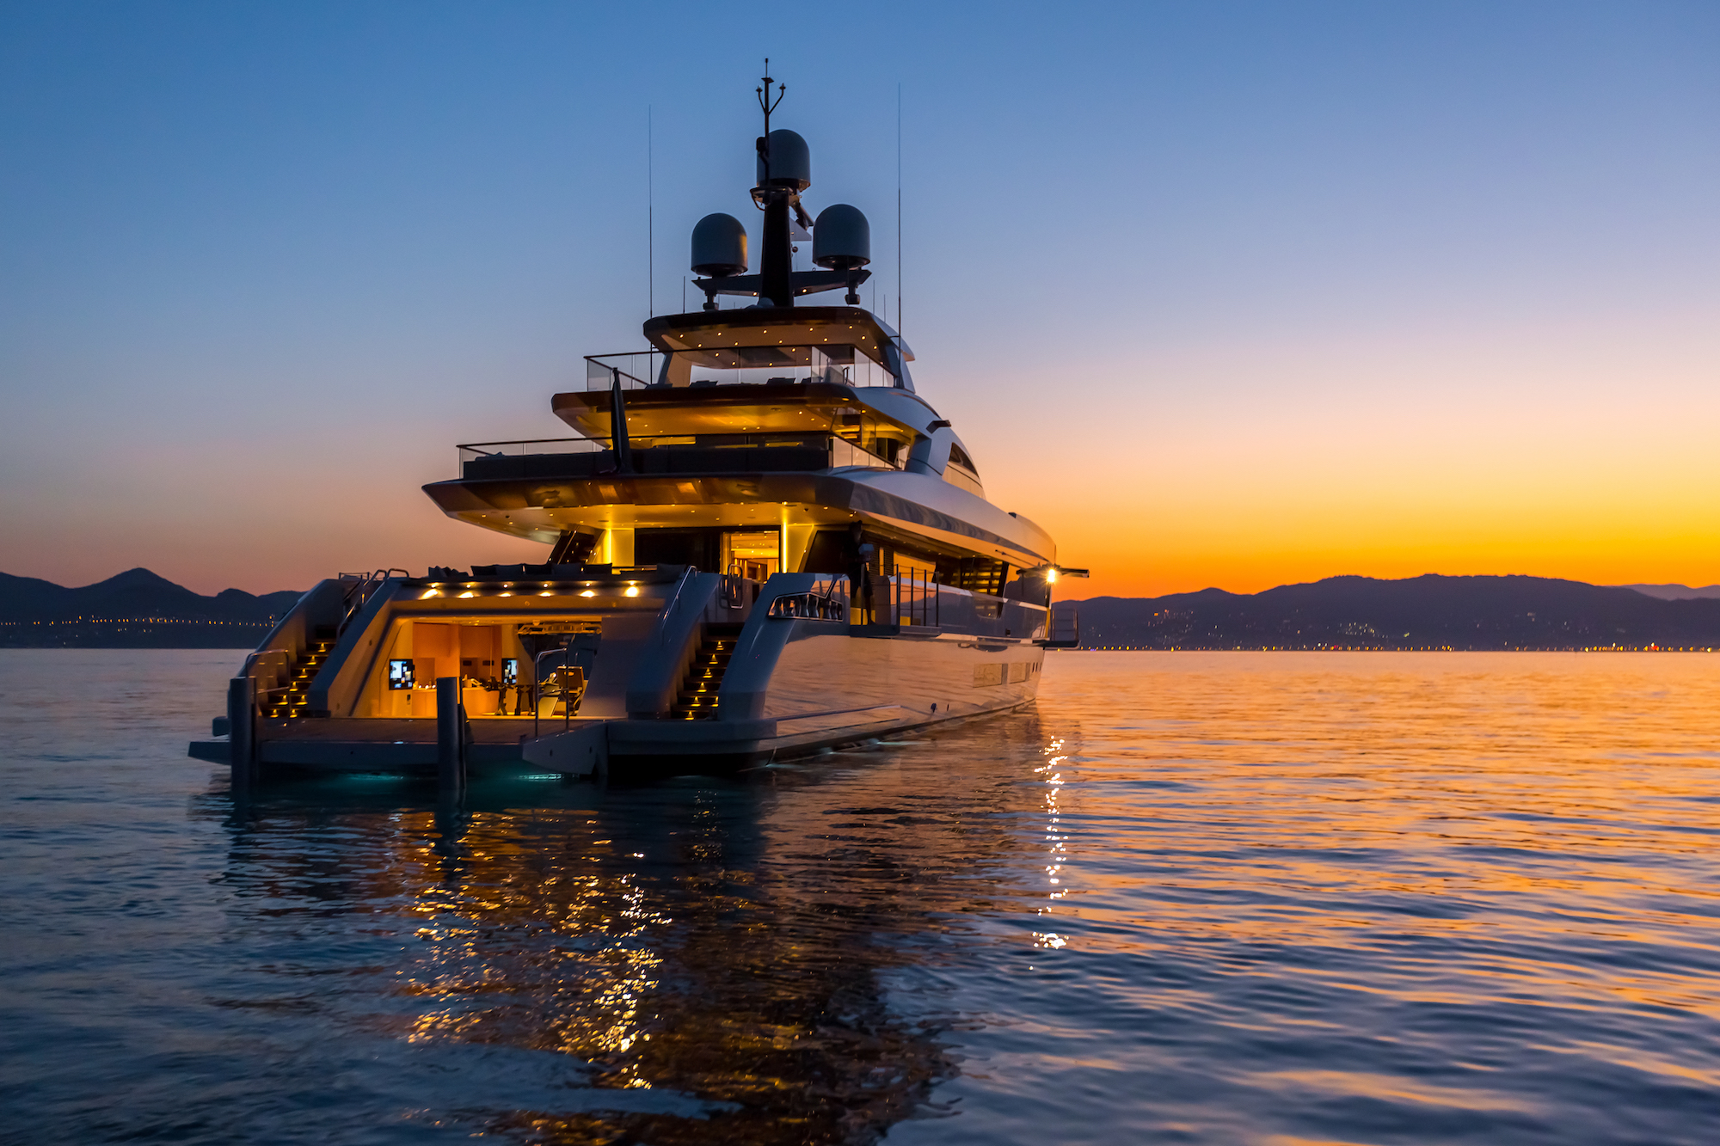

Boat Sale Price Prediction
Gabe Corridor, Josh Schrock, Marisela Miranda, Other?
Analysis of boat size, make, & model
20,000 x 26 Dataset
Regression
https://www.kaggle.com/datasets/mexwell/boat-price-prediction

Slide 2

Image Link
https://www.charterworld.com/index.html?sub=gallery&image=9722.2fd64

